Slide 1





DAg Factory
A declarative, configuration-driven tool managed by Astronomer for generating Airflow DAGs dynamically using YAML files.

Slide 2


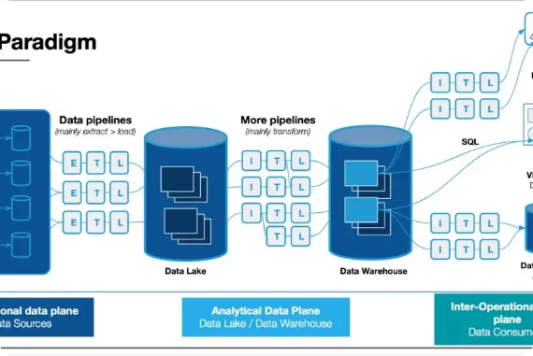
What is DAg Factory & Why Use It?
Declarative Pipeline Generation: Allows creating fully functional Airflow DAGs entirely from YAML configurations without writing complex Python scripts.
Eliminates Python Boilerplate: Removes redundant Airflow boilerplate code, task dependency setup, and operator instantiation.
Separation of Logic & Structure: Decouples the operational workflow structure (YAML) from the actual processing code (Python/SQL).
Astronomer Open Source: Maintained directly by Astronomer, ensuring enterprise reliability and seamless compatibility with Airflow 2.x+.

Slide 3
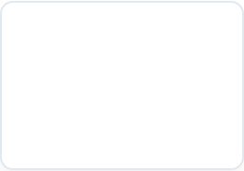
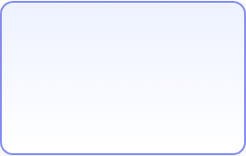
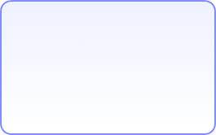





DAg Factory Architecture & Flow
YAML Configs
Generator Script
Airflow DAG Bag
Airflow UI Execution
Write pipeline specs in dags/configs/*.yaml defining tasks & schedules.
Python script imports dagfactory & parses directory on Airflow loop.
Dynamically constructs DAG objects post-deploy during parsing.
DAGs rendered in Airflow Webserver ready for schedule or trigger.
Post-Deploy Generation: Adding or updating YAML files instantly creates new Airflow DAGs without code redeploys.
Single Loader Script: A 4-line Python file parses hundreds of YAML configurations dynamically.
Zero Memory Bloat: Cleanly decouples task definition from Airflow scheduler execution memory.

Slide 4
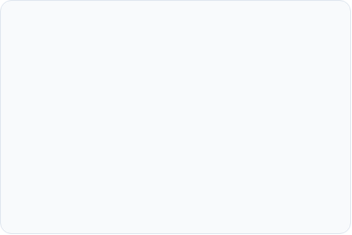

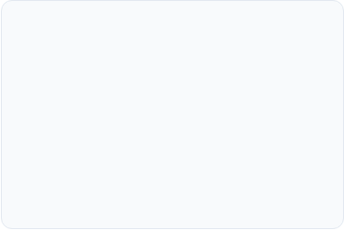


Who Benefits & Target Audiences
Data Analysts & SQL Devs
Analytics Engineers
Data Platform Teams
Build and orchestrate production-grade data pipelines using simple YAML without needing deep mastery of Airflow primitives or Python paradigms.
Standardize repetitive Extract-and-Load (ELT) jobs across the enterprise. Easily duplicate workflow structures by updating YAML parameters.
Enforce strict architectural guidelines, streamline pull request code reviews, and drastically reduce DAG processor parser overhead.

Slide 5

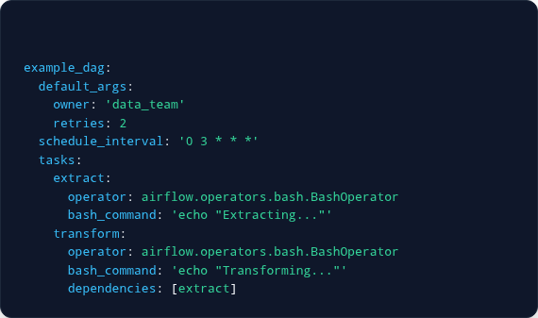



High-Level Setup & Usage Example
dags/configs/my_pipeline.yaml YAML
Install Dependency
Add dag-factory to your Airflow requirements.txt or environment.
Write YAML Definition
Create a configuration YAML file under dags/configs/my_dag.yaml.
One-Time Python Generator
Add a 4-line standard loader script in dags/generate_dags.py using dagfactory.DagFactory().

Slide 6


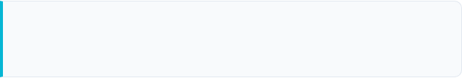
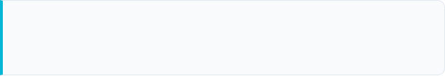
Impact on Delivery & Efficiency
70%+ Reduction in Python Code
Eliminates repetitive Python boilerplate across engineering teams, accelerating daily sprint throughput.
80%
Zero Airflow Python Learning Curve
Enables non-Python domain experts to safely author production-ready DAGs without syntax errors.
Faster Pipeline Time-to-Market
Accelerated CI/CD Validation
Declarative YAML schemas allow instant linting and syntax checking before deployment to Airflow environments.

Slide 7
Maintenance, Scaling & Governance
Modular Project Architecture
Template-Driven Scale (DRY)
Clean Git Auditing
Keep YAML configs in dags/ and reusable Python scripts in include/tasks/. This prevents the DAG processor from parsing execution logic unnecessarily.
Avoid duplicating code. Generate dozens of similar ingestion DAGs dynamically from a single master YAML template with different parameter inputs.
Diffing YAML file changes during Pull Requests is straightforward and human-readable, reducing bugs, security vulnerabilities, and deployment risks.

Slide 8

Image Sources
https://montecarlo.ai/wp-content/uploads/2023/07/what-is-data-pipeline-architecture.webp
Source: montecarlo.ai

